Slide 1

Dapp Hello world
Nguyen Huy Hoang

Slide 2
OUTLINE
Compare
Web app vs dApp
1
Prepare environment and deploy a dApp on local
2
Create a dApp model with https://eth.build/
3

Slide 3
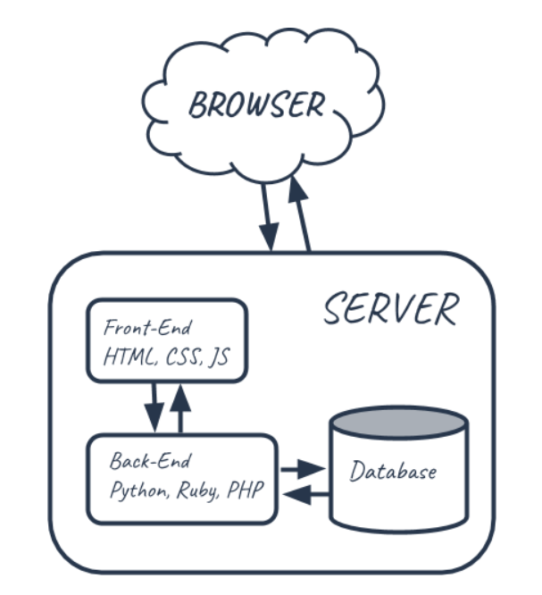
WEB APP ARCHITECTURE
 | Web App
Front-end | HTML, Javascript, Typescript, Angular …
Back-end | WebAPI (Python, Ruby, PHP, .NET, Java, …)
Database | Centralize DB (MySQL, SQL Server, Oracle, …)

Slide 4
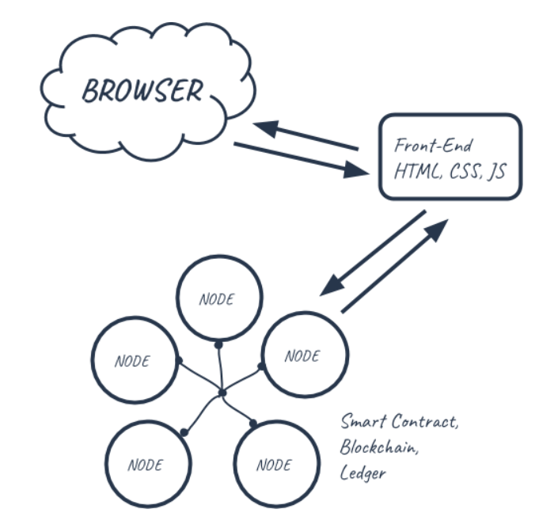
DAPP ARCHITECTURE
 | Dapp
Front-end | HTML, Web3, javascript
Back-end | Solidity, Smart contract
Database | Decentralize data on a full node
Properties:
Code is shared, verifiable and unchangeable
Data is shared
Blockchain is network and is database
Peer to peer and decentralized app

Slide 5
COMPARE
1. COMPARE A WEB APP AND A DAPP ON BLOCKCHAIN
 | Web App | Dapp
Front-end | HTML, Javascript, Typescript, Angular .. | HTML, Web3, javascript
Back-end | WebAPI | Solidity, Smart contract
Database | Centralize DB (MySQL, SQL Server, Oracle, …) | Decentralize data on a full node

Slide 6


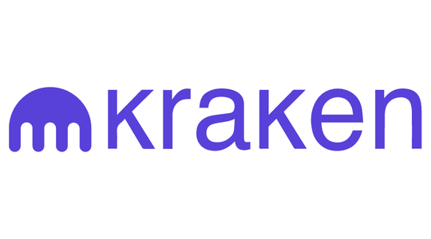


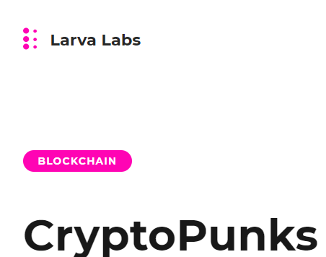
- Cryptocurrency market: Binance, Coinbase, Kraken …
1. WHAT IS DAPP ON REAL WORLD ?
- Collectible market based on Non-fungible (NFT) tokens: Cổng trời, OpenSea, CryptoPunks …

Slide 7
2. DEMO AND BUILD A DAPP STEPS
2.1. Setup environment
2.2. Create a smart contract
2.3. Deploy a smart contract
2.4. Build a Web UI for access Smart Contract
2.5. Run the Dapp

Slide 8
2.1. Setup environment
Install Ubuntu on VirtualBox
Install build-essential:
$ sudo apt-get install -y build-essential
Nodejs : version 12
$ curl -sL https://deb.nodesource.com/setup_12.x | sudo -E bash –
$ sudo apt -y install nodejs
If you use latest version NodeJS, Solidity can have errors when compile with Ganache;
Update latest Node Package Manager (NPM)
Truffle Framework: allow us to create, compile and deploy a smart contract to blockchain network
$ npm install -g truffle
Install Solidity library
$ npm install –g solc

Slide 9
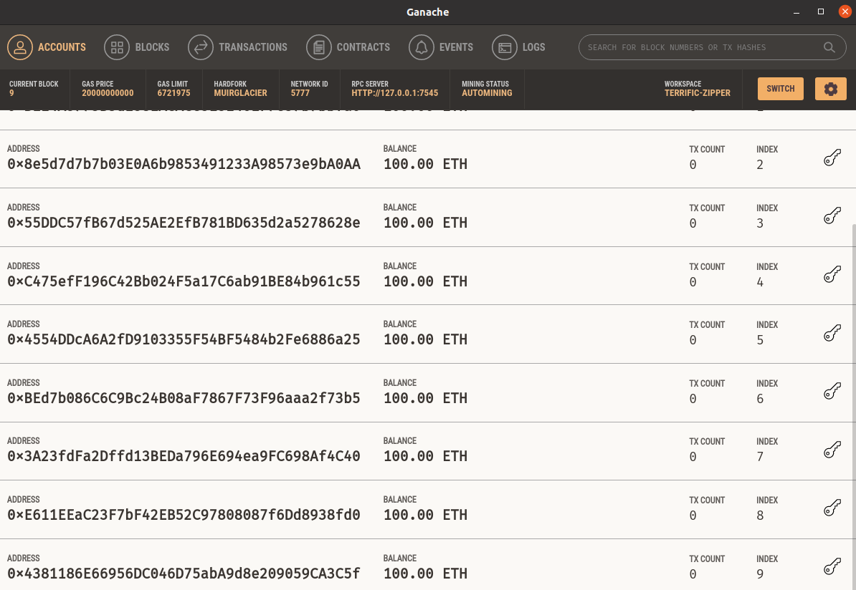
2.1. Setup environment
Ganache: is a personal blockchain for rapid Ethereum and Corda distributed application development
Download from site https://www.trufflesuite.com/ganache and run

Slide 10
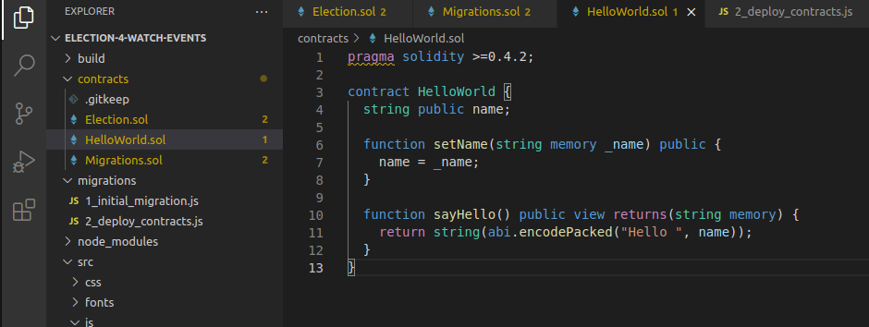
2.2 Create a smart contract
Create a smart contract with Solidity

Slide 11
2.3 Deploy and debug a smart contract
$ truffle compile
Compiling your contracts...
truffle migrate –-reset
Deploy your contract to your current ETH network
truffle debug <contract hash>
Debug your contract
o) step over, (i) step into, (u) step out, (n) step next
truffle console
Run test functions in a contract
$ HelloWorld.deployed().then((instance) => { Hello = instance; });
truffle(ganache)> Hello
truffle(ganache)> Hello.setName("Hoang")
truffle(ganache)> Hello.sayHello()
Debug with Truffle framework

Slide 12
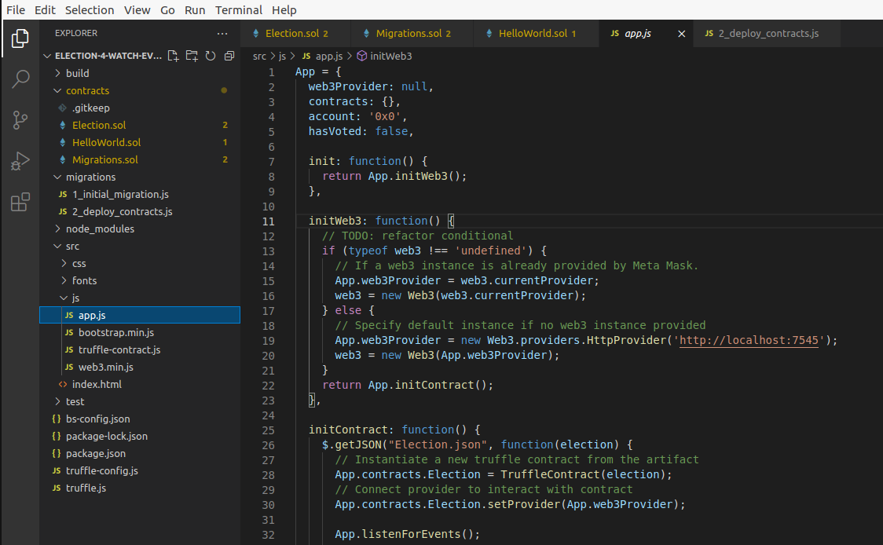
2.3 Build a Web UI for access Smart Contract
Use Web3.js library to connect with network
Get and put value to Smart Contract via Web3 lib

Slide 13
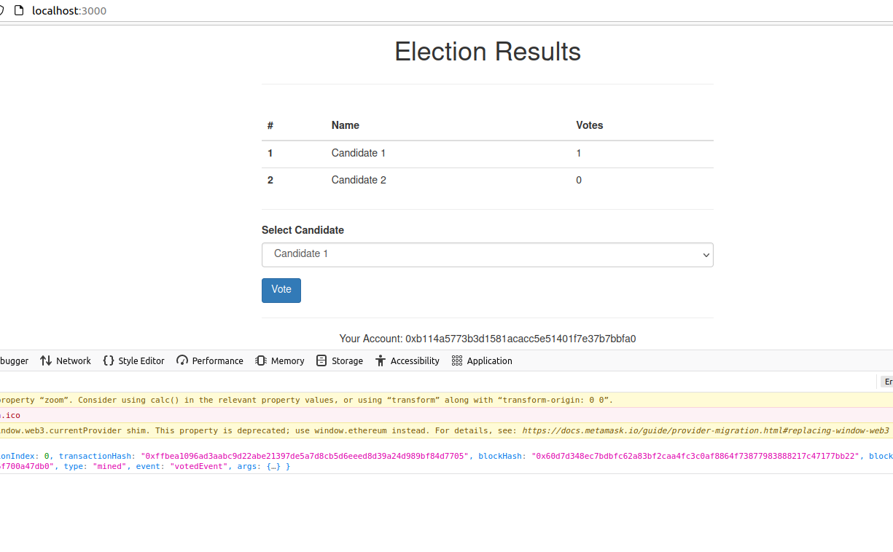
2.3 Run the Dapp
Install lite-server:
$ npm install lite-server
Run Front-end web:
$ npm run dev
Connect front-end web to network using MetaMask addon

Slide 14
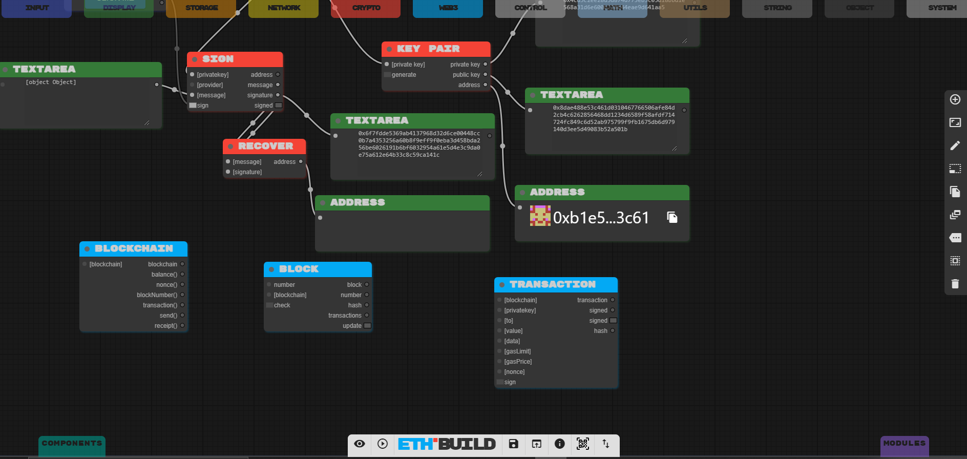
3. Create a dApp model with https://eth.build/

Slide 15
THANK YOU FOR LISTENING
Q&A

